Slide 1
Research at TULIP Lab
Gang Li
School of Information Technology
Deakin University, Australia

Slide 2
Outline
TULIP Lab
Who?
What?
How?
Research at TULIP
Training at TULIP
Rules in TULIP

Slide 3
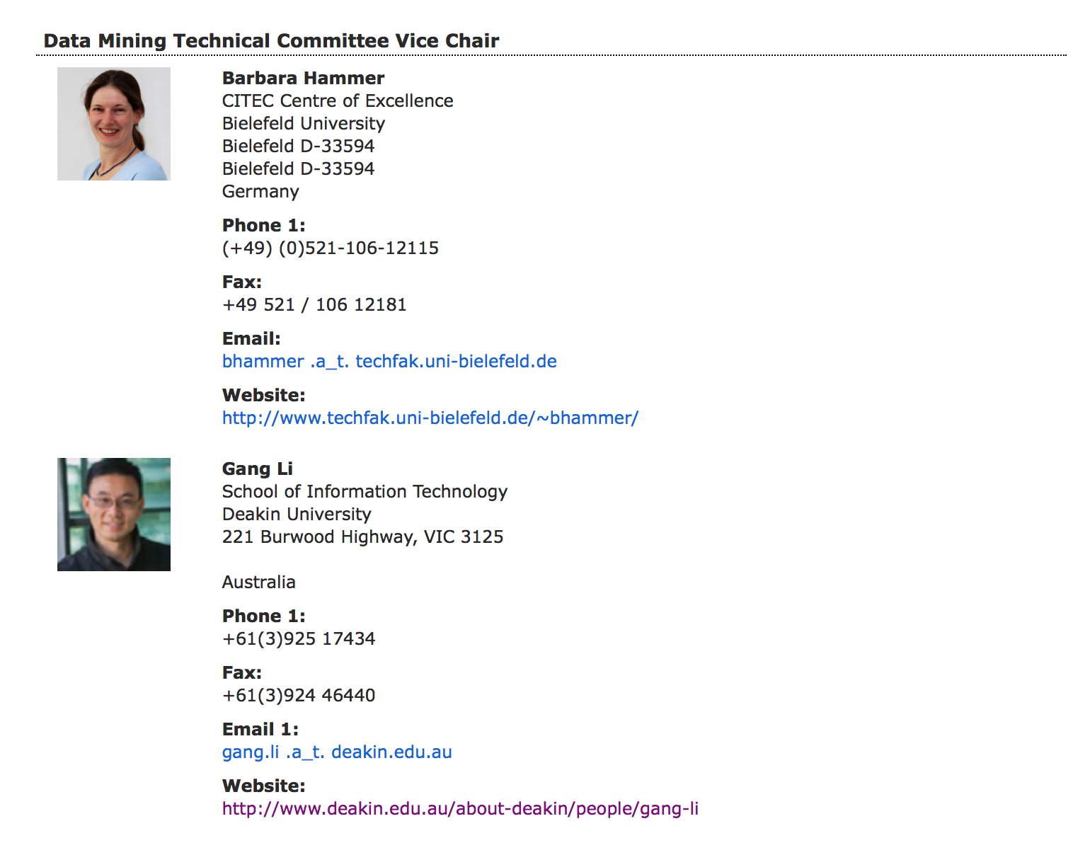
TULIP Team (http://www.tulip.org.au)
A/Prof. Gang Li
IEEE Technical Committee
IEEE Task Force on EDM (Vice chair)
Data Mining and Big Data Analytics (Vice Chair 2017)
Enterprise Architecture and Engineering
Enterprise Information Systems
Deakin
University Thesis Examination Committee
SEBE Faculty HDR Director
Current Director for
S578/S678/S778/S779 (Master of Information Technology)
Founding Director for
S306 (Bachelor of Computer Science)
S777 (Master of Data Science)

Slide 4
TULIP Lab (http://www.tulip.org.au)
Homepage : http://www.tulip.org.au
Twitter: tulipacademy
Weibo: https://weibo.com/tulipacademy
Github: https://github.com/tulip-lab
Tulip Calendar:
https://calendar.google.com/calendar/embed?src=1trnk46p4gae8ev410ku57sba4%40group.calendar.google.com&ctz=Australia%2FSydney
https://calendar.google.com/calendar/ical/1trnk46p4gae8ev410ku57sba4%40group.calendar.google.com/public/basic.ics

Slide 5
Lab Oragnization
TULIP Lab
Academy: all members
Headquarter: PhD and Postdoc in Melbourne
Master: master students
Trainee: members to be assessed for research lab entry
FLIP00
FLIP01
...
Web TeVisitor: visiting members
am: web site maintaining team, publicity team

Slide 6
Section Breaker

Slide 7
Research at TULIP (Team for Universal Learning and Intelligent Processing)
Current Research Themes@ TULIP Lab
Behavior Informatics
Periodic Behavior Mining
Behavior Prediction
Information Abuse Prevention
Data Compliance Checking
Privacy Preservation in Data Mining
Business Intelligence Applications
Recommender System
Tourism/Hospitality Management

Slide 8


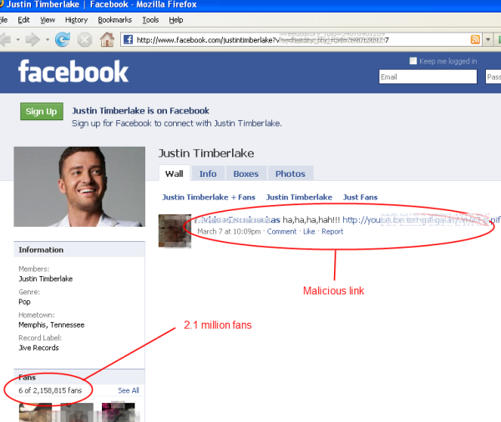


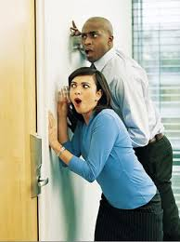

Theme 1. Behavior Informatics
People share news, interests and ideas in OSNs,
though these platforms also spread email malware, rumours, gossips and malicious links, and also leak our privacy.

Slide 9

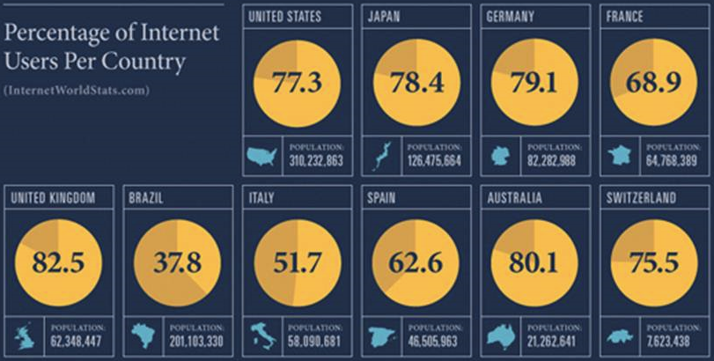
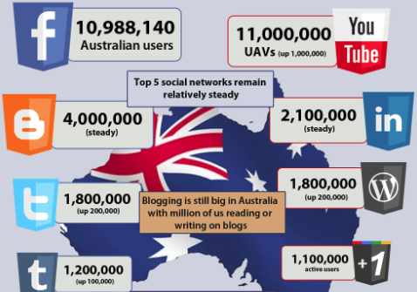
The Popularity of Online Social Networks
The popularity of OSNs has greatly increased in recent years
A large amount of Internet users also use OSN services,
Australia has up to 11 million Facebook users.

Slide 10
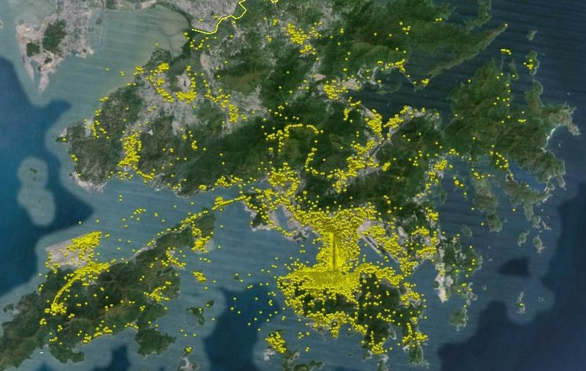

Application of Geo Photos
There are many geotagged photos available. However :
Data is noisy or misleading.
Photos are taken in transit rather than at the attractions.
Photo is static media, whereas, travel behavior is dynamic.
How to mine these data for travel behaviour analysis?

Slide 11
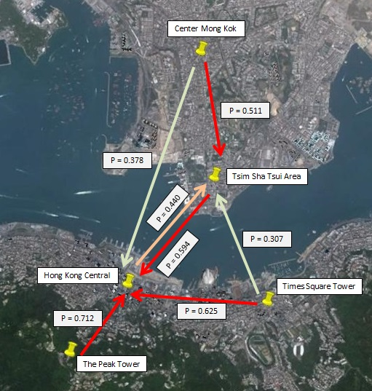
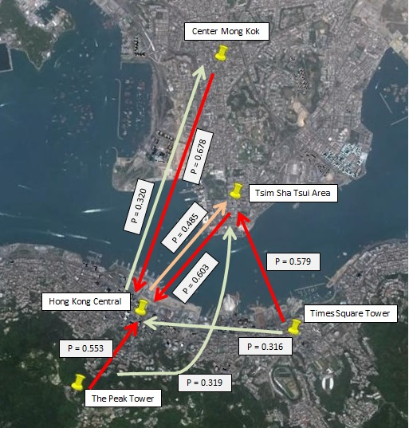
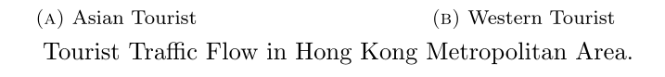
Tourist Movement Analysis
Notes:
Asian Tourists are likely to flow to Hong Kong central area from surrounding areas Tourist from Center Mong Kok tend to visit Tsim Sha Tsui as the next destination while, somes chose to travel directly to Hong Kong Central. Considerable tourist flow are found from Hong Kong Central and Times Square Towers to Tsim Sha Tsui
Western tourists tend to visit Hong Kong Central directly right after visiting Center Mong, while, somes travel in the opposite direction. Tourists are more likely to visit Tsim Sha Tsui than Hong Kong Central after visiting Times Square Towers. Some tourists visited Tsim Sha Tsui right after going to the Peak Tower.

Slide 12
Tourist Movement Analysis
Huy Quan Vu, Gang Li, Rob Law, Ben Haobin Yip. Exploring the travel behaviors of inbound tourists to Hong Kong using Geotagged photos. Tourism Management.

Slide 13
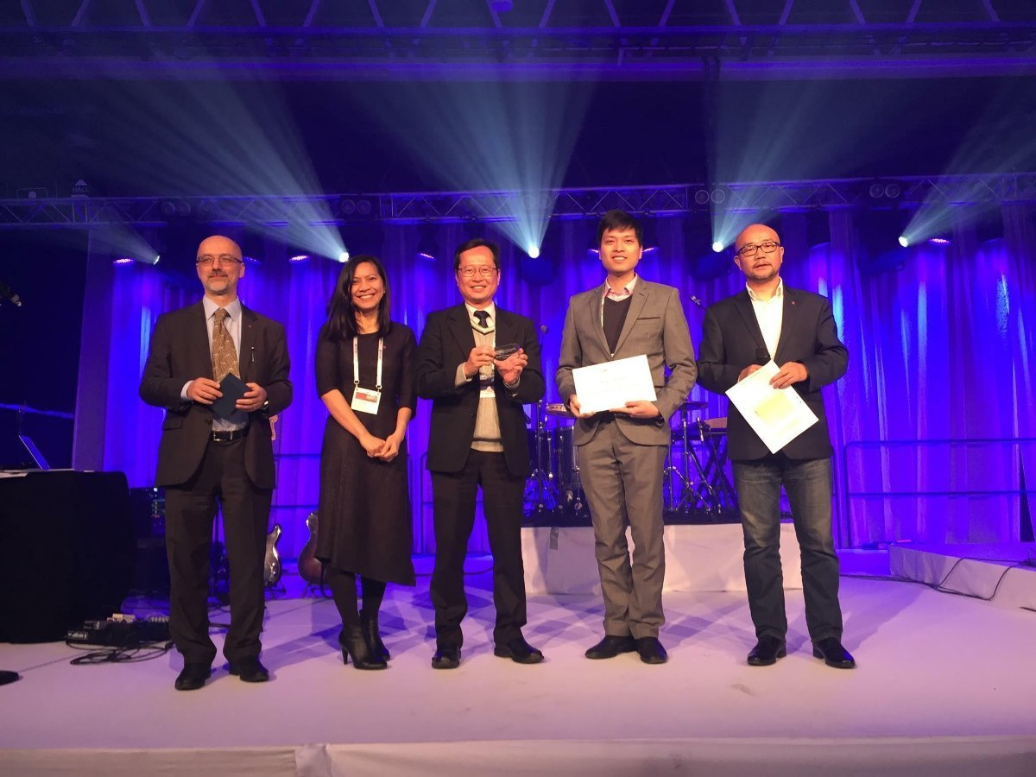
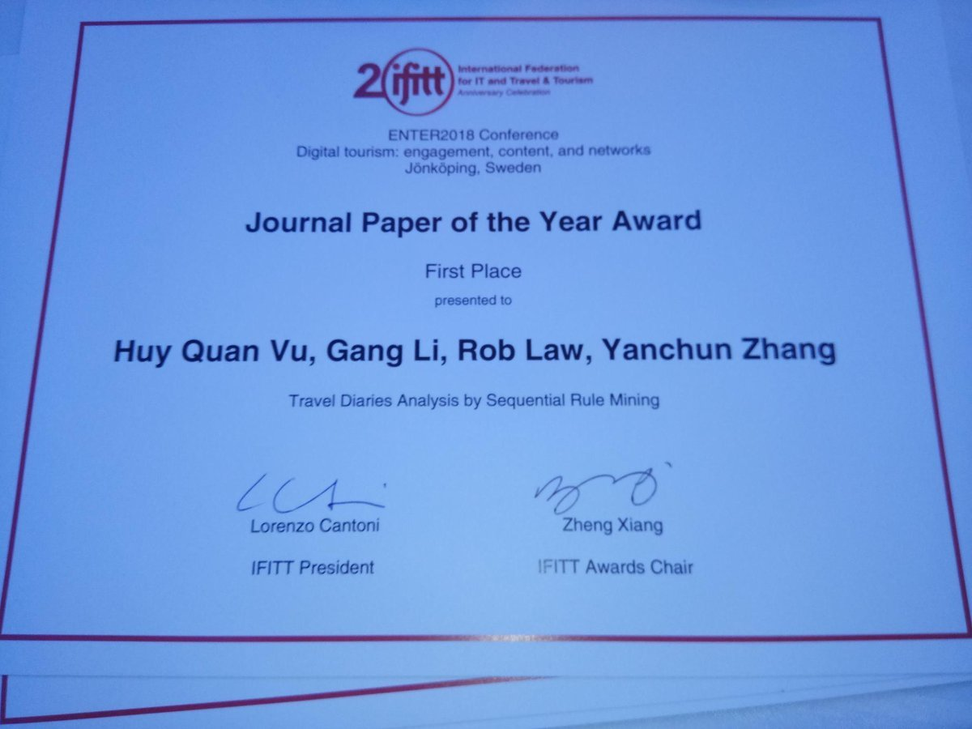
Tourist Movement Analysis

Slide 14
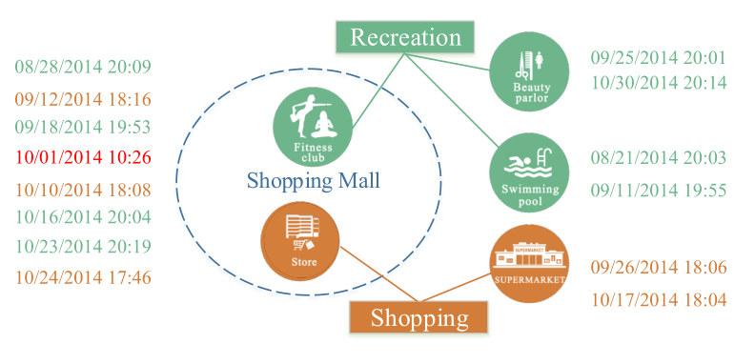
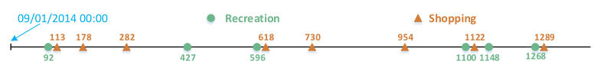
Periodic Behavior Mining
Observed Check-in Data is usually a mixed events from different periodic behaviors
What are Periodic?
What is the period?
Predict the Behavior on a particular day

Slide 15
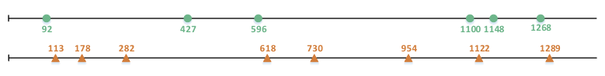
Periodic Behavior Mining
Observed Check-in Data is usually a mixed events from different periodic behaviors
What are Periodic?
What is the period?
Predict the Behavior on a particular day

Slide 16
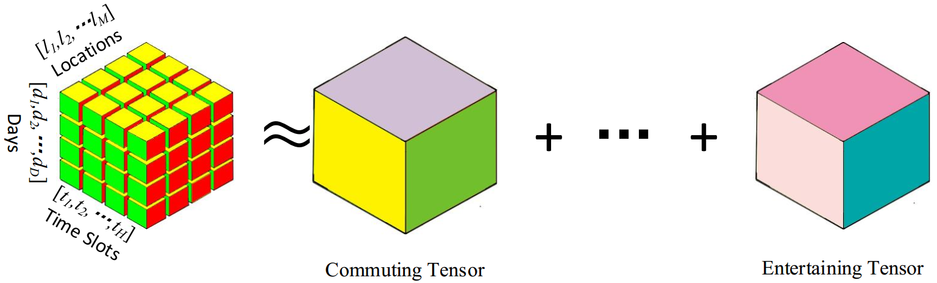
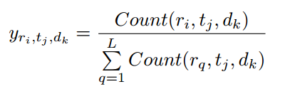


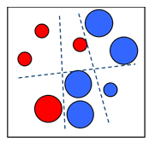











Periodic Behavior Mining Mobility Intentions
CP Decomposition
Users’ history records
Mobility Intention Sequence
… …
Mobility Intentions
…
… …
multi-class classifier

Slide 17
Periodic Behavior Mining Applications
There are various applications of Periodic Behavior Mining
What is the schedule of a person on a particular day/time?
Where to find the person on a particular day/time?
Police applications
Scheduled “Encountering” for match making
Timely Recommendation Systems
Now it is the time for you to stock rice, cooking oil, or ice cream!

Slide 18
P.R. Applications (Case 1: Face Age Recognition)
Xin Geng, Zhi-Hua Zhou, Yu Zhang, Gang Li, Honghua Dai. Learning from facial aging patterns for automatic age estimation. Proceedings of the 14th annual ACM international conference on Multimedia, 2006

Slide 19
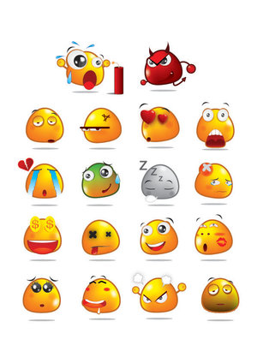

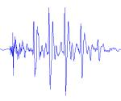
P.R. Applications (Case 2: Speech-based Emotion Detection)
Jia Rong, Gang Li, Yi-Ping Phoebe Chen: Acoustic Feature Selection for Automatic Emotion Recognition from Speech. Information Processing and Management, 45(3): 315-328 2009

Slide 20
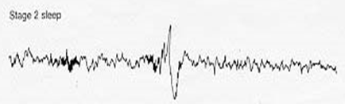
P.R. Applications (Case 3: K-Complex Detection)
Sleep Stage Identification
Rapid Eye Movement (REM) Sleep
A normal stage of sleep characterized by the rapid movement of the eyes (is relatively easily discernible in PSG)
20%-25% of total sleep time in human adults, memorable dream
Non-REM Sleep
N1: slow eye movement, hypnic jerks at beginning, believe fully awake
N2: non eye movement, rare dreaming, easily awaken
N3: deep sleep, sometimes dreaming, but disconnected, less vivid
General sleep order in cycles of REM and NREM: N1 → N2 → N3 → N2 → REM
Early in the night, a greater amount of deep sleep (N3)
Later in the night, REM sleep increases, and before natural awakening
Vu, Quan; Li, Gang; Sukhorukova, Nadezda; Beliakov, Gleb; Liu, Shaowu; et al. K-complex Detection using a Hybrid-Synergic Machine Learning method. IEEE Transactions on SMC(C), PP(99): 1-13.

Slide 21
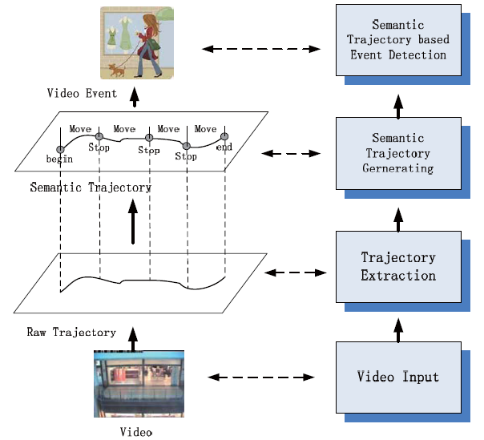
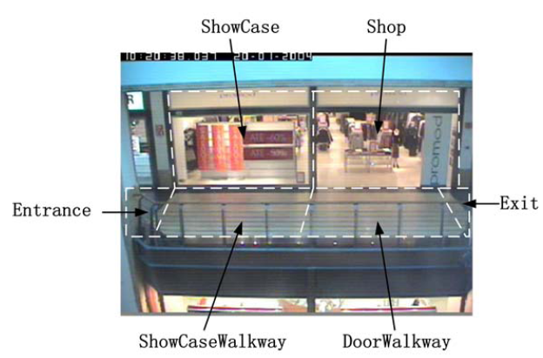
P.R. Applications (Case 4: Trajectory Analysis)
Xiaofeng Wang, Gang Li, Guang Jiang, Zhongzhi Shi. Semantic Trajectory based Event Detection and Event Pattern Mining, Knowledge and Information Systems (KAIS), pp. 1-25, 2011.

Slide 22
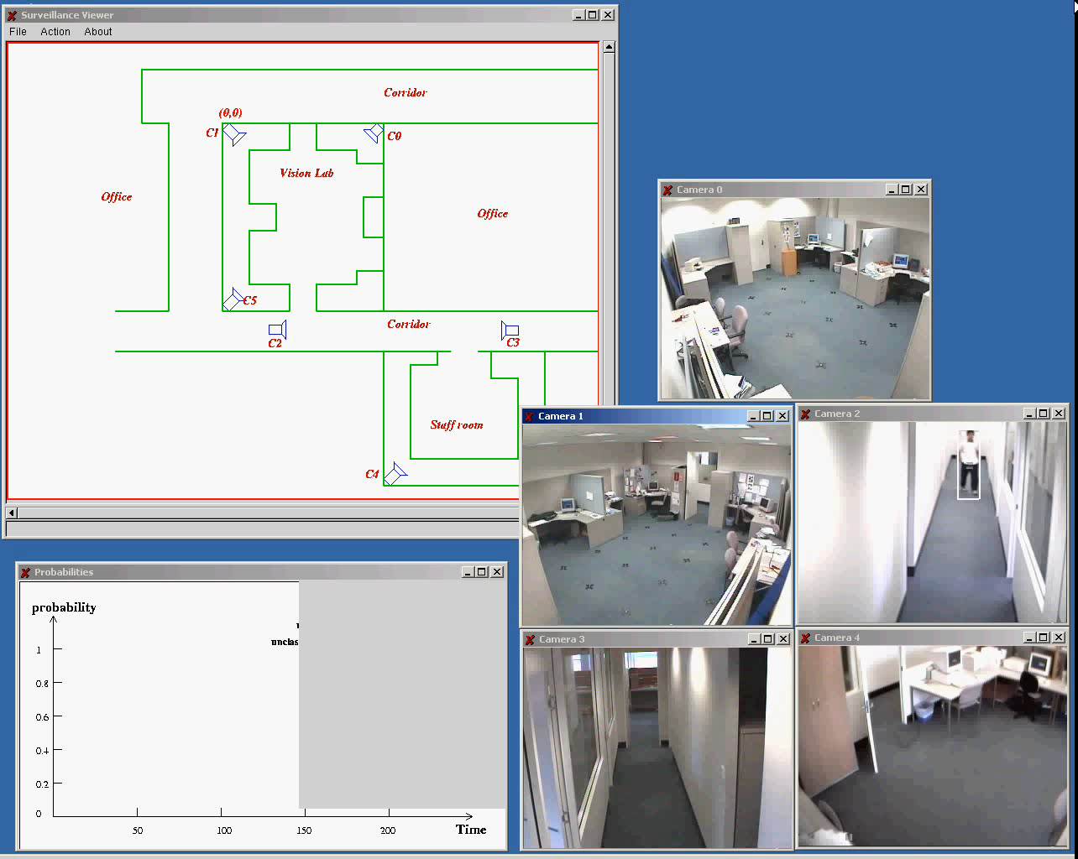
P.R. Applications (Case 5: Video Surveillance)

Slide 23
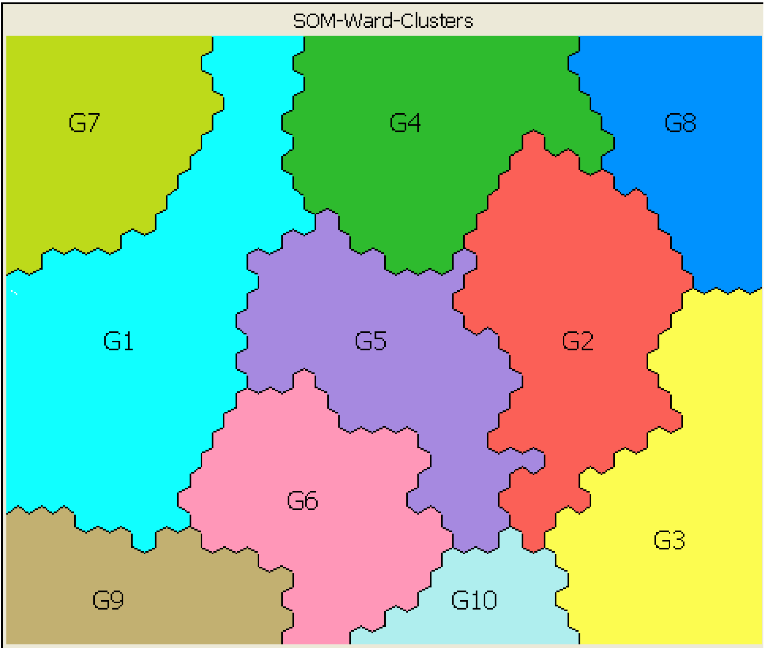
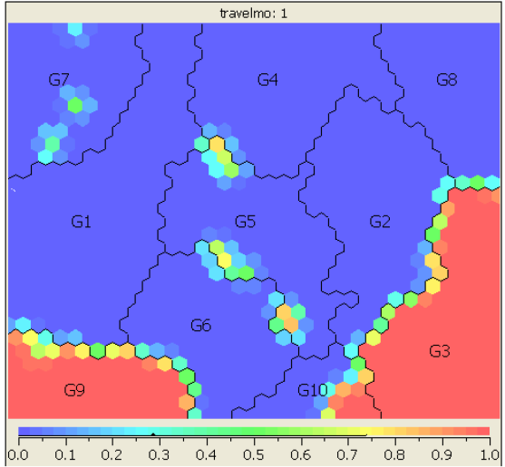
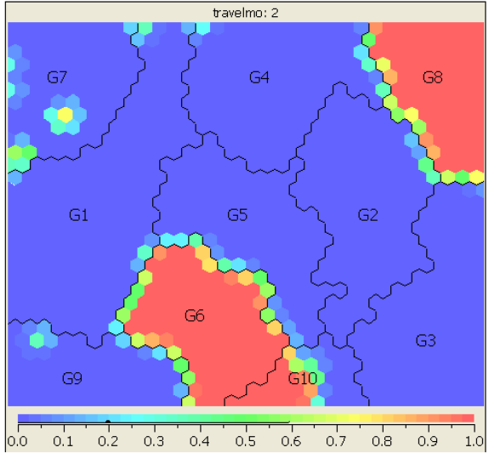
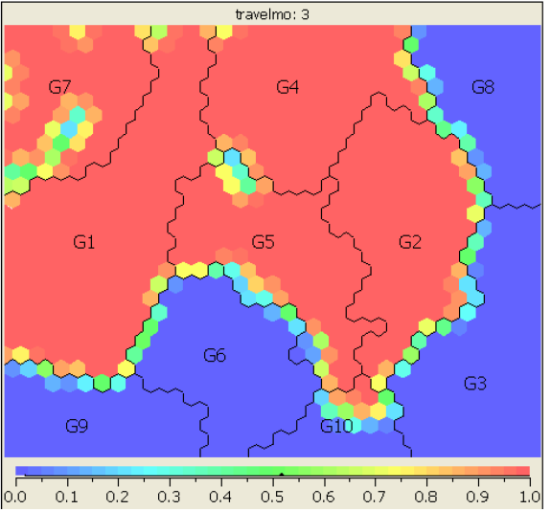
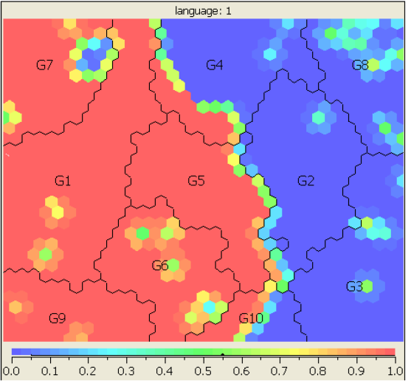
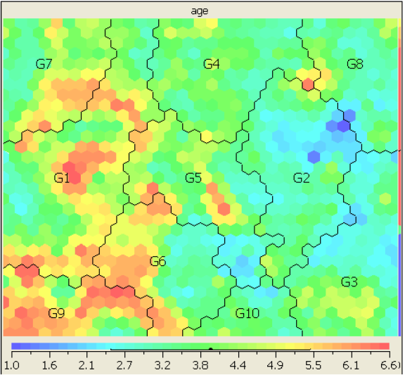
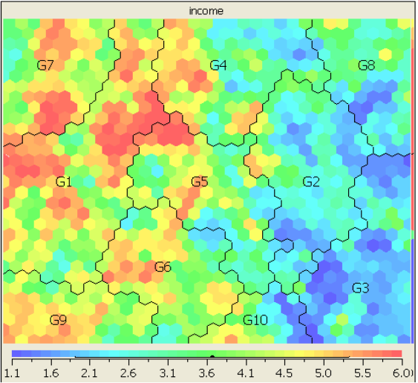
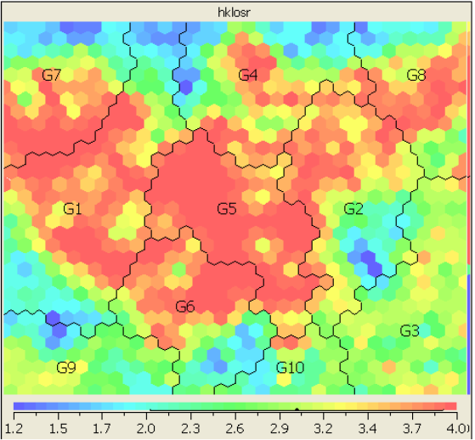
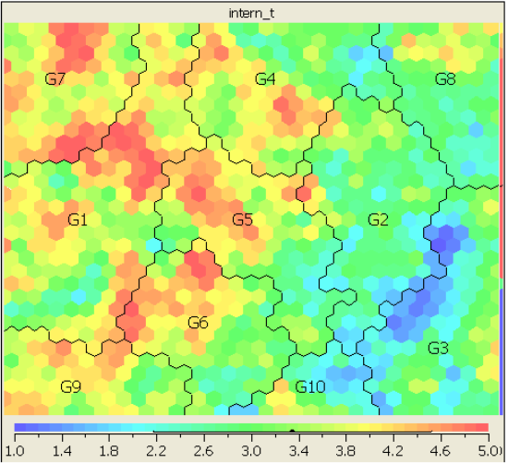
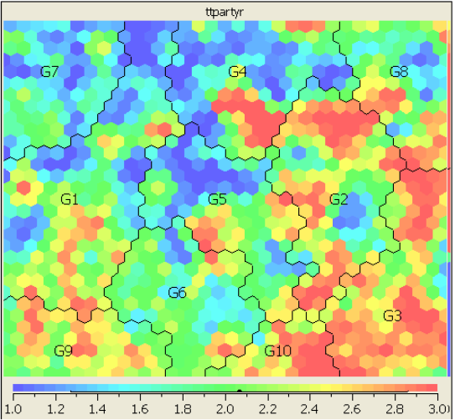
Market Segmentation Analysis
Travel Mode: 1
Travel Mode: 2
Travel Mode: 3
Language: 1
Age
partially packaged
Income
HK Length of Stay
Travel Experience
High income
Travel Party
Low income
partially packaged
old
Fully packaged
Fully packaged
Notes:
Asian Tourists are likely to flow to Hong Kong central area from surrounding areas Tourist from Center Mong Kok tend to visit Tsim Sha Tsui as the next destination while, somes chose to travel directly to Hong Kong Central. Considerable tourist flow are found from Hong Kong Central and Times Square Towers to Tsim Sha Tsui
Western tourists tend to visit Hong Kong Central directly right after visiting Center Mong, while, somes travel in the opposite direction. Tourists are more likely to visit Tsim Sha Tsui than Hong Kong Central after visiting Times Square Towers. Some tourists visited Tsim Sha Tsui right after going to the Peak Tower.

Slide 24
Negative Association Rule Mining
Transaction
Data
Sup(AUB) ≥ min_sup
Candidate Interesting Positive
Item-set
lever(AUB) ≥ min_lever
Generating Targeted
Item-set
Interesting Positive Item-set
User specified
Target Item
confi(A→~B) ≥ min_confi
Sup(AUB) < min_sup
Positive
Rules
Candidate Interesting Negative
Item-set
lever(AU~B) ≥ min_lever
confi(A→~B) ≥ min_confi
Interesting Negative Item-set
Negative
Rules
Reporting
Rules

Slide 25
Contrast Mining
Contrast Targeted Rules Algorithm (CTR):
Detect the changes of rules strength between differences year data set.
Tracing the trend for predicting future potential.
2008
2010
V.S
?
A→B
A→B
?
A→B
A→B
2008
2009
2010
2011
…

Slide 26
Theme 2. Information Abuse Prevention
Information Abuse:
The compromise of information for which the data stakeholders are not willing to disclose.
It depends on the nature of the information, the involved internal or external users, and the ways in which the organization grants the access to or releases the information.

Slide 27
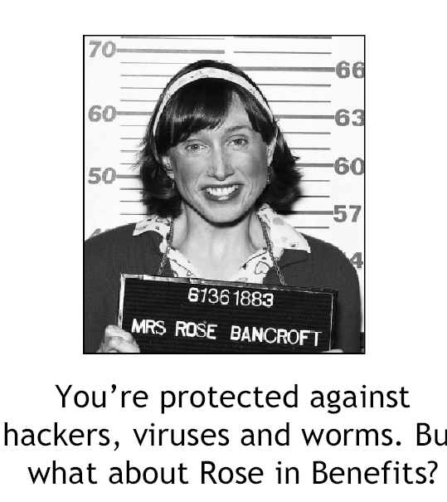
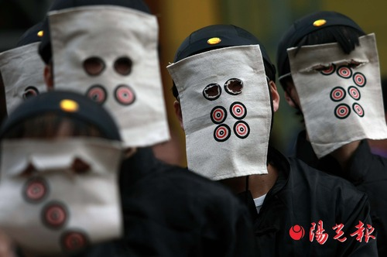
Who is an adversary?
Every user is potentially an adversary
After data is released, we cannot prevent any user from performing any type of analysis on the released data
Worst case scenario
Must account for disclosure risk from any and all types of analyses

Slide 28
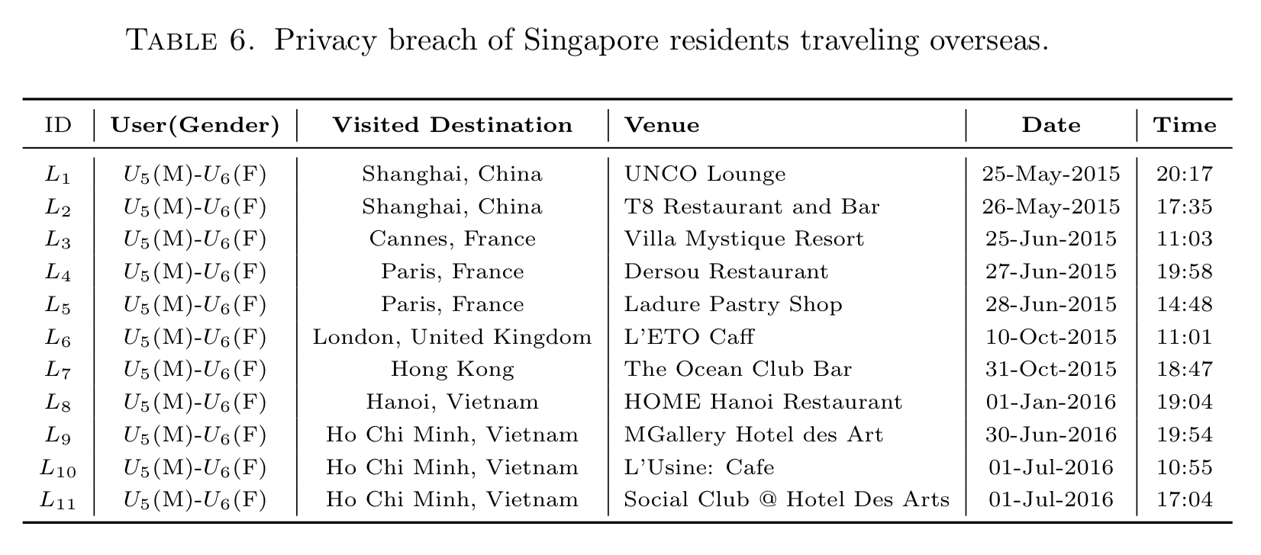
Privacy Breach Example (1)

Slide 29
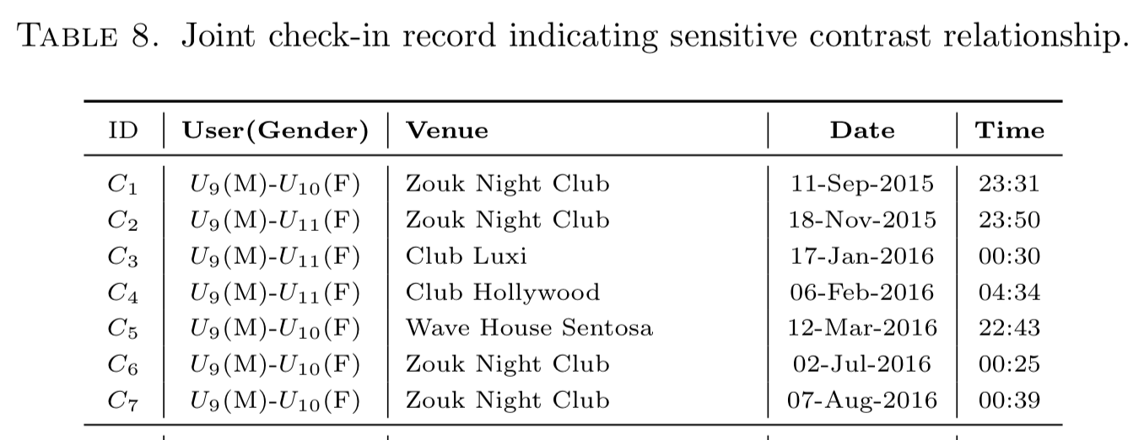
Privacy Breach Example (2)

Slide 30
Is O.S.N. a Secure Place to Show off?

Slide 31
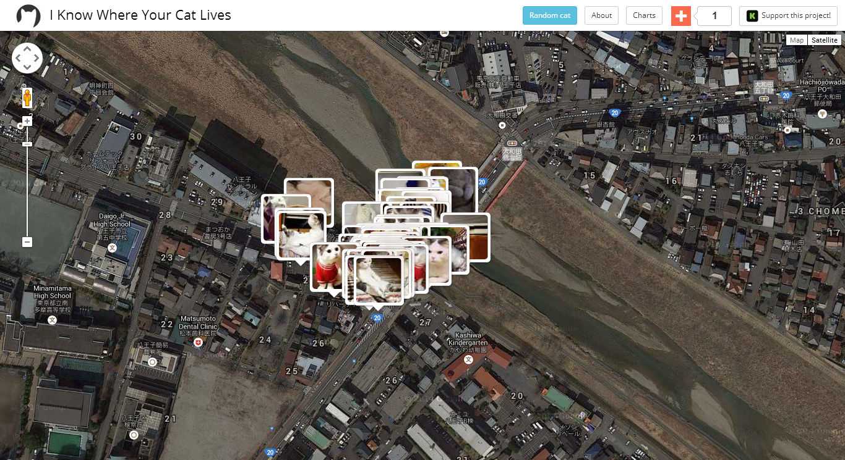
I Know Where Your Cat Lives
This project randomly selected one million images that include the word “cat” across public photo sites, which plots the location coordinates from each photo against a map to show where each cat lives. ---- July 22, 2014 Time
http://time.com/3019671/i-know-where-your-cat-lives-website-data-visualization/
Notes:
Mashable points out that a new data visualization project called “I Know Where Your Cat Lives” is trolling the internet and collecting metadata in your #adorable #cat #picture. Using the geotags embedded in the metadata in public photos, the project collects the information and puts the cat’s location on a map perfect for cyberstalking your fuzzy feline friend.
http://time.com/3019671/i-know-where-your-cat-lives-website-data-visualization/
The site features cats from everywhere around the globe — a giant red tom in Chiba, Japan to a grey fuzzball kitten in Apulia, Italy to a kitten cuddled with his mom in Queensland, Australia — all available for gawking at and cooing over at the click of a button.

Slide 32
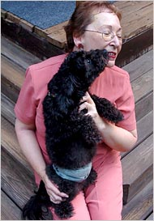
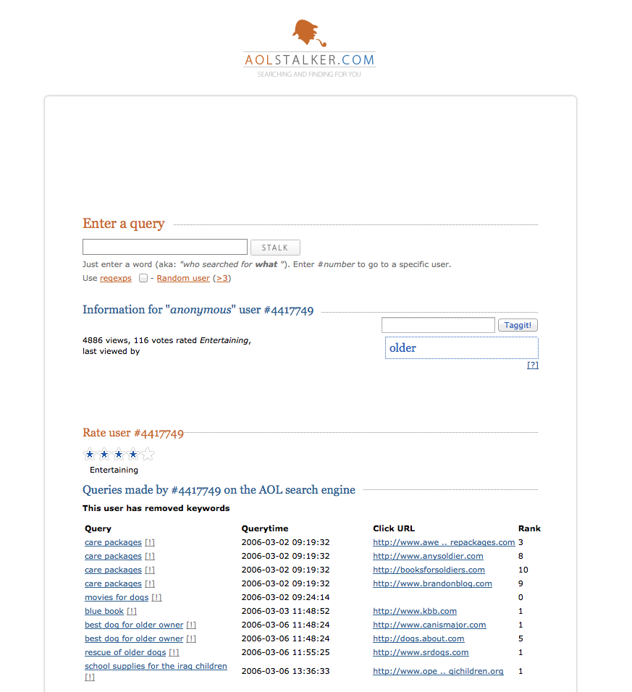
AOL Dataset Debacle
AOL search data leak (2006):
36 million search terms of 650,000 users
http://search-id.com
http://www.aolstalker.com
I Know who you are
Click history can uniquely identify a person
Find all log entries for AOL user 4417749
Multiple queries for businesses and services in Lilburn, GA (population 11K)
queries for Jarrett Arnold
Lilburn has 14 people with the last name Arnold
NYT contacts them, finds out User 4417749 is Thelma Arnold

Slide 33
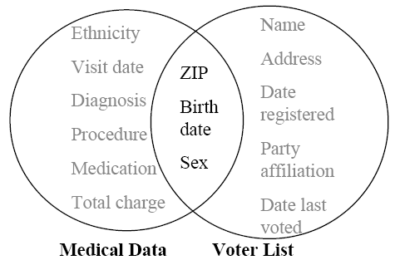
Breach of medical record
87% of Americans can be uniquely identified by
{zip code, gender, date of birth}
Latanya Sweeney re-identify the medical record of an ex-governor of Massachusetts.
[International Journal on Uncertainty, Fuzziness and Knowledge-based Systems, 2002]

Slide 34
Breach of medical record
Linkage Attacks
Using “innocuous” data in one dataset to identify a record in a different dataset containing both innocuous and sensitive data
At the heart of the voluminous research on hiding small cell counts in tabular data

Slide 35
Privacy Preserving Related Reference
Privacy Preserving in Data Releasing
T. Zhu, G. Li, W. Zhou, P.S. Yu. Differential Privacy and Its Applications: Survey, IEEE Transactions on Data and Knowledge Engineering, 2017
T. Zhu, G. Li, W. Zhou, P.S. Yu. Differential Privacy and Its Applications, Springer 2017
T. Zhu, P. Xiong, G. Li, W. Zhou. Correlated Differential Privacy: Hiding Information in Non-IID Dataset. IEEE Transactions on Information Forensics & Security, 2015, 10(2), 229-242

Slide 36
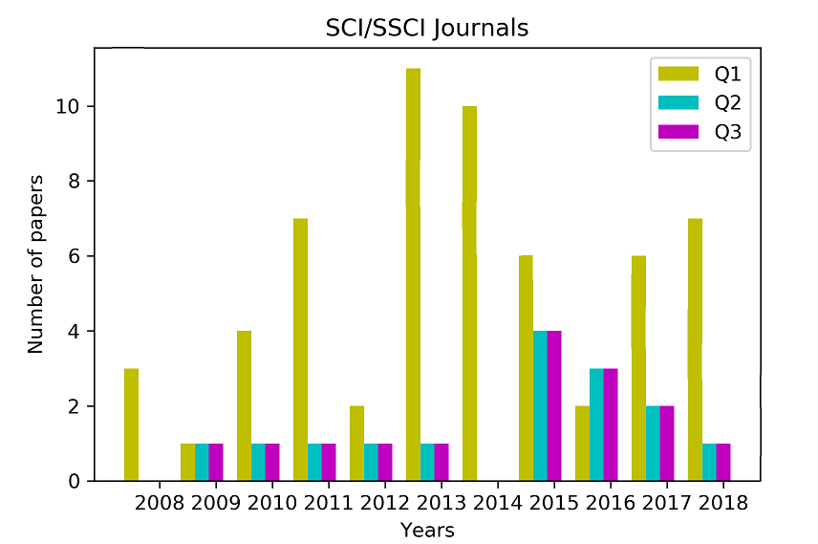
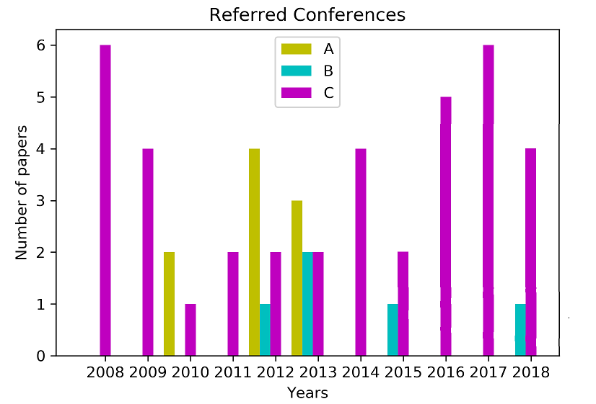
Our rankings
 |  | 2008 | 2009 | 2010 | 2011 | 2012 | 2013 | 2014 | 2015 | 2016 | 2017 | 2018
SCI/SSCI Journals (84) | Q1(70%) Q2(18%) Q3(12%) | 3 0 0 | 1 1 0 | 4 1 0 | 7 1 1 | 2 1 2 | 11 1 0 | 10 0 2 | 6 4 1 | 2 3 1 | 6 2 1 | 7 1 2
Referred Conferences (52) | A (17%) B (10%) C (73%) | 0 0 6 | 0 0 4 | 2 0 1 | 0 0 2 | 4 1 2 | 3 2 2 | 0 0 4 | 0 1 2 | 0 0 5 | 0 0 6 | 0 1 4
#Deakin is 211th in the World and TOP TEN in Australia.

Slide 37
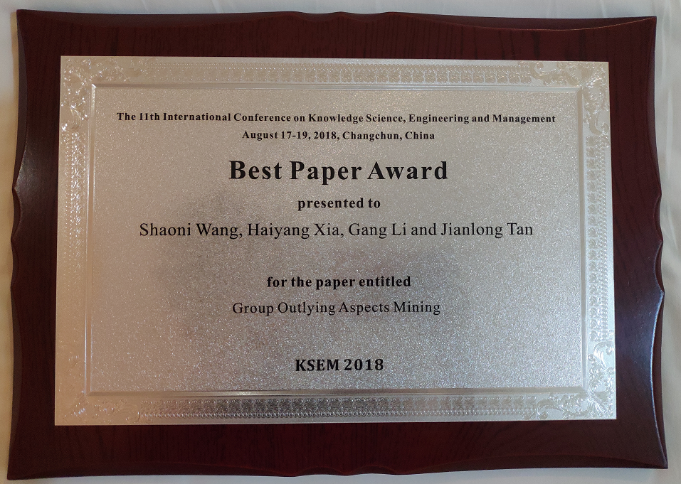
Clearly list our paper awards details in a table
Year | Author | Awards
2017 2015 2007 | Huy Quan Vu Huy Quan Vu Jingyu Hou | IFITT Journal Paper of The Year Award (1st Prize) IFITT Journal Paper of The Year Award (3rd Prize) Springer Nightingale Prize
2018 2016 2014 2012 | Shaoni Wang Dali Zhu Tianqing Zhu Yongli Ren | KSEM 2018 Best Paper Award IEEE TrustCom 2016 Best Student Paper Award Best Student Paper Award 2012 ACM ASONAM Best Paper Award

Slide 38
Section Breaker

Slide 39
Training at TULIP (Team for Universal Learning and Intelligent Processing)
Professional knowledge
LaTeX, Version Control Systems (SmartGit GitHub Bitbucket)
Plan & Progress Review
References Management
Foundational Knowledge
FLIP (00) ~ FLIP (05)
Research Skills
Review Team
Reading Team
QQ Online
At least once a month
Read material before meeting, ask questions.
FLIP(00): Data Science
FLIP(01): Advanced Data Science
FLIP(02): Modern Data Science
FLIP(03): Deep Learning
FLIP(04): Learning Theory (I)
FLIP(05): Learning Theory (II)
Review Team
Reading Team

Slide 40
Training at TULIP (Team for Universal Learning and Intelligent Processing)
Learning content (FLIP00 ~ FLIP05)
Mathematics
Linear algebra, Probability theory, Mathematical statistics
Hands-on ability
Python, Spark, Cloud platform
Learning theoretical knowledge
Optimization, Graph model
Professional knowledge
All of materials are English.

Slide 41
Moving to Higher Stages
TULIP Academy:
Complete FLIP(00)~ FLIP(01) with test on Kaggle Project
Read materials before TULIP Seminar and ask questions.
Learn LaTeX & PPR
Trainee:
Complete FLIP(02)~ FLIP(03) with Kaggle
Report in TULIP Seminar
SmartGit, Bitbucket and Mendeley
Infinity:
Meeting with Gang Leader twice a week (Research)
Complete FLIP(04)~FLIP(05)

Slide 42
Section Breaker

Slide 43
Regulations
TULIP Academy
You must not be absent from the meeting without permission.
Xi'an group members must attend the seminar in the Lab, and NOT online.
Collaborate with team members, rather than attacking each other.
FLIP Study
All FLIP students need to pass the corresponding prerequisite.
All FLIP materials are confidential, and you should not circulate it outside.
Research
SmartGit, Bitbucket, Mendeley, update PPR in time.
Actively discuss research work in the group meeting, and TULIP Seminar.
Everyone should prepare at least one question for each TULIP seminar.

Slide 44
Questions?

Slide 45
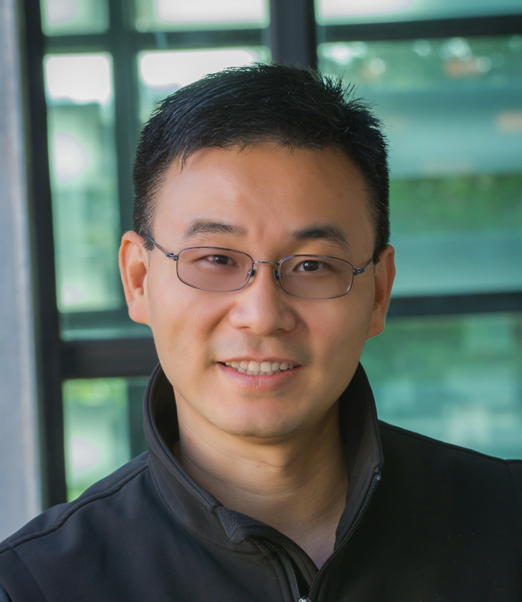
Contact
A/Prof. Gang Li
School of IT, Deakin University VIC 3125, Australia
gang.li@deakin.edu.au
Phone: +61(3)925-17434
Office: T207.WS14 (Burwood)

